Slide 1
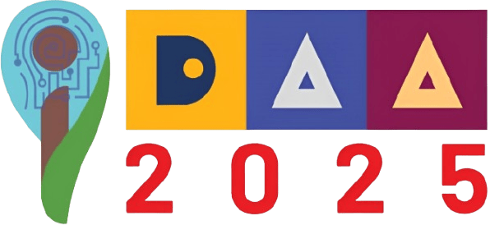



International Conference on Intelligent Data Analysis and Applications (IDAA 2025)
Paper Id: 10700
Paper Title: ConstitutionGPT-BD: Resilient Bilingual Legal QA with
Hybrid RAG and Automatic Fallback
Presenter Name: Mehedi Hasan
University Name: Daffodil International University
Daffodil International University, Daffodil Smart City Birulia, Savar, Dhaka-1216, Bangladesh

Slide 2
Contents
Introduction
Problem Statement
Related work
Research Questions
Objectives
Outcomes and Impacts
Methodology
Experimental Results
Conclusion
Future Research Direction
References
Daffodil International University, Daffodil Smart City Birulia, Savar, Dhaka-1216, Bangladesh

Slide 3
Introduction
What is it?
An intelligent chatbot that answers questions about the Bangladesh Constitution
Supports both English and Bengali languages
Uses RAG (Retrieval-Augmented Generation) technology
Available 24/7 through web, API, and command-line interfaces
Daffodil International University, Daffodil Smart City Birulia, Savar, Dhaka-1216, Bangladesh

Slide 4
Problem Statement
Current Challenges:
Accessibility Issue
Bangladesh Constitution: 170+ pages of dense legal text
Difficult for ordinary citizens to navigate and understand
No quick way to find specific information
Cost & Availability
Legal consultation is expensive
No free 24/7 accessible legal guidance
Time-consuming to research independently.
Daffodil International University, Daffodil Smart City Birulia, Savar, Dhaka-1216, Bangladesh

Slide 5
Related work
Ref | Author(s) | Year | Research Focus | Method / Approach | Key Contribution | Limitation / Gap
[1] | Lewis et al. | 2021 | Retrieval-Augmented Generation (RAG) | Transformer-based RAG combining neural retriever and generator | Introduced RAG framework enabling external knowledge retrieval | Limited evaluation in legal/domain-specific data
[2] | Reuter et al. | 2025 | Reliable retrieval in legal RAG | Dense & hybrid retrieval pipelines + dataset-level analysis | Improves retrieval correctness for legal corpora | Focused on retrieval only, not generation quality
[3] | Huang et al. | 2024 | AI alignment through public participation | Collective Constitutional AI framework | Improves model safety and fairness using public constraints | Not applied to domain-specific QA
[4] | Abdallah et al. | 2023 | Legal QA systems | Comparative study and taxonomy | Comprehensive overview of legal QA methods | No experimental model implementation
[5] | Trautmann et al. | 2025 | QA groundedness (arXiv) | New grounding metrics | Measures hallucination and answer-source alignment | Not evaluated on conversational AI
[6] | Trautmann et al. | 2024 | Grounded legal QA | Empirical evaluation with labeled legal datasets | Introduces evaluation framework for grounded answers | Dataset size limited
Daffodil International University, Daffodil Smart City Birulia, Savar, Dhaka-1216, Bangladesh

Slide 6
Related work continued
Research Gap:
No bilingual (English-Bengali) constitutional chatbot
Lack of automatic fallback mechanisms in legal AI
Limited RAG applications for Bangladesh legal documents
Our Contribution:
First bilingual Bangladesh Constitution chatbot
Novel automatic fallback (Gemini → FLAN-T5)
Comprehensive evaluation framework for legal RAG systems
Daffodil International University, Daffodil Smart City Birulia, Savar, Dhaka-1216, Bangladesh

Slide 7
Research Questions
RQ1: Architecture & Design
Can a RAG-based system effectively answer constitutional queries in both English and Bengali?
RQ2: Retrieval Accuracy
What retrieval strategy (similarity search vs MMR) provides better coverage of relevant constitutional articles?
RQ3: Language Detection
How accurately can the system detect and handle English, Bengali, and code-switched queries?
RQ4: Reliability
Can automatic fallback mechanisms ensure continuous operation when primary LLM APIs fail?
RQ5: Performance
What are the tradeoffs between response time and answer quality across different LLM backends (Gemini vs FLAN-T5)?
Daffodil International University, Daffodil Smart City Birulia, Savar, Dhaka-1216, Bangladesh

Slide 8
Objectives
Build RAG System with Automatic Fallback - Core technical system
Enable Bilingual Language Support - English and Bengali language capabilities
Daffodil International University, Daffodil Smart City Birulia, Savar, Dhaka-1216, Bangladesh

Slide 9
Outcomes and Impacts
Achieved Outcomes:
Working bilingual chatbot with 683 Constitution chunks (382 EN, 301 BN)
100% language detection accuracy for English and Bengali
93.1% scope classification accuracy (constitutional vs non-constitutional)
82.5% retrieval success rate (Recall@5)
Automatic fallback system tested and verified (Gemini → FLAN-T5)
Key Impacts:
Democratize Legal Knowledge: Free access to constitutional information for all citizens
Fast & Reliable: 2-second average response with zero-downtime fallback
Educational Tool: Help law students, teachers, and researchers
Daffodil International University, Daffodil Smart City Birulia, Savar, Dhaka-1216, Bangladesh

Slide 10
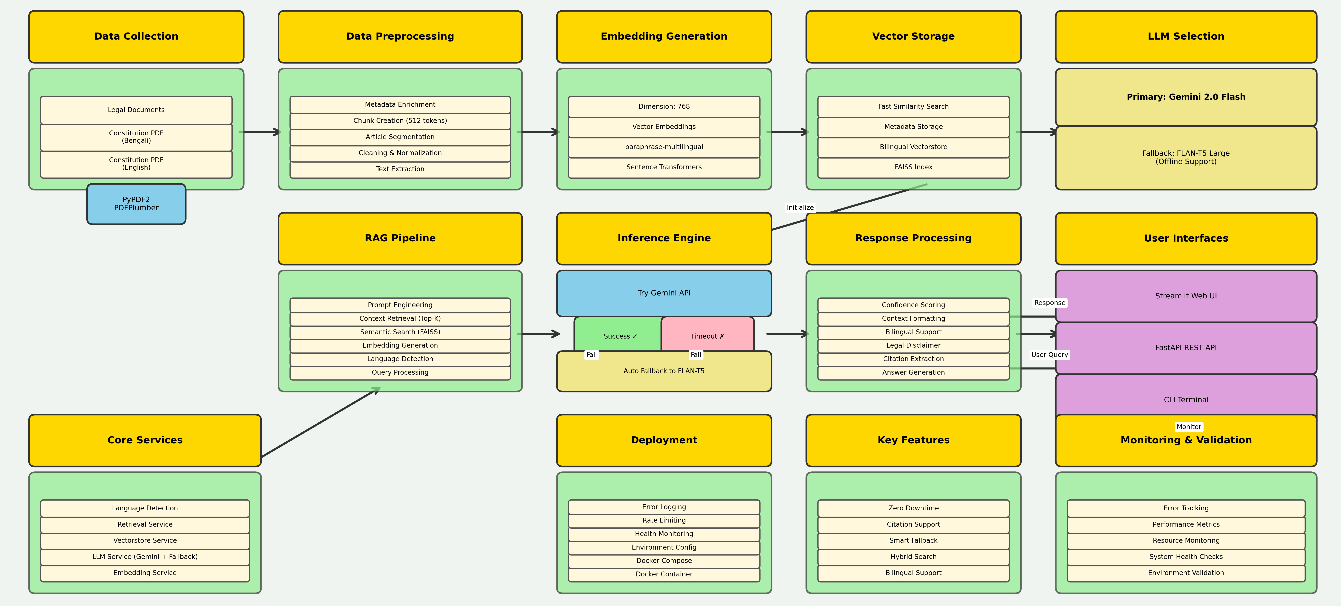
Methodology
Fig: System Architecture
Daffodil International University, Daffodil Smart City Birulia, Savar, Dhaka-1216, Bangladesh

Slide 11
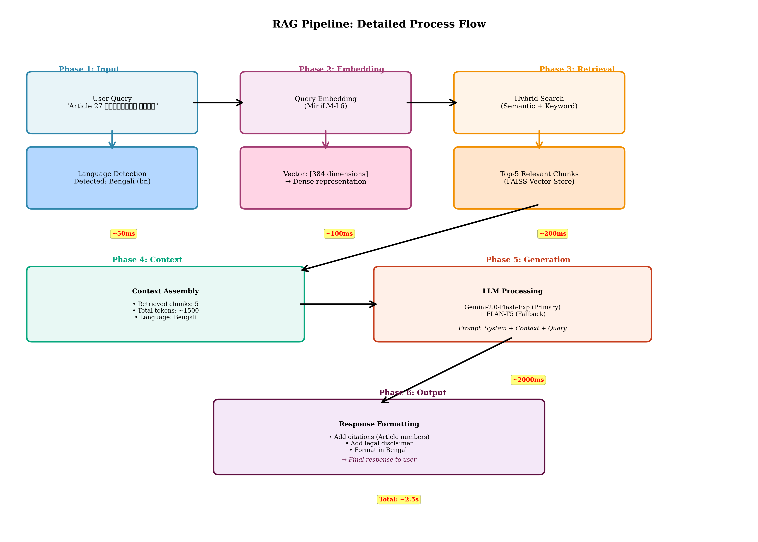
Methodology Continued
Fig: System Architecture
Daffodil International University, Daffodil Smart City Birulia, Savar, Dhaka-1216, Bangladesh

Slide 12
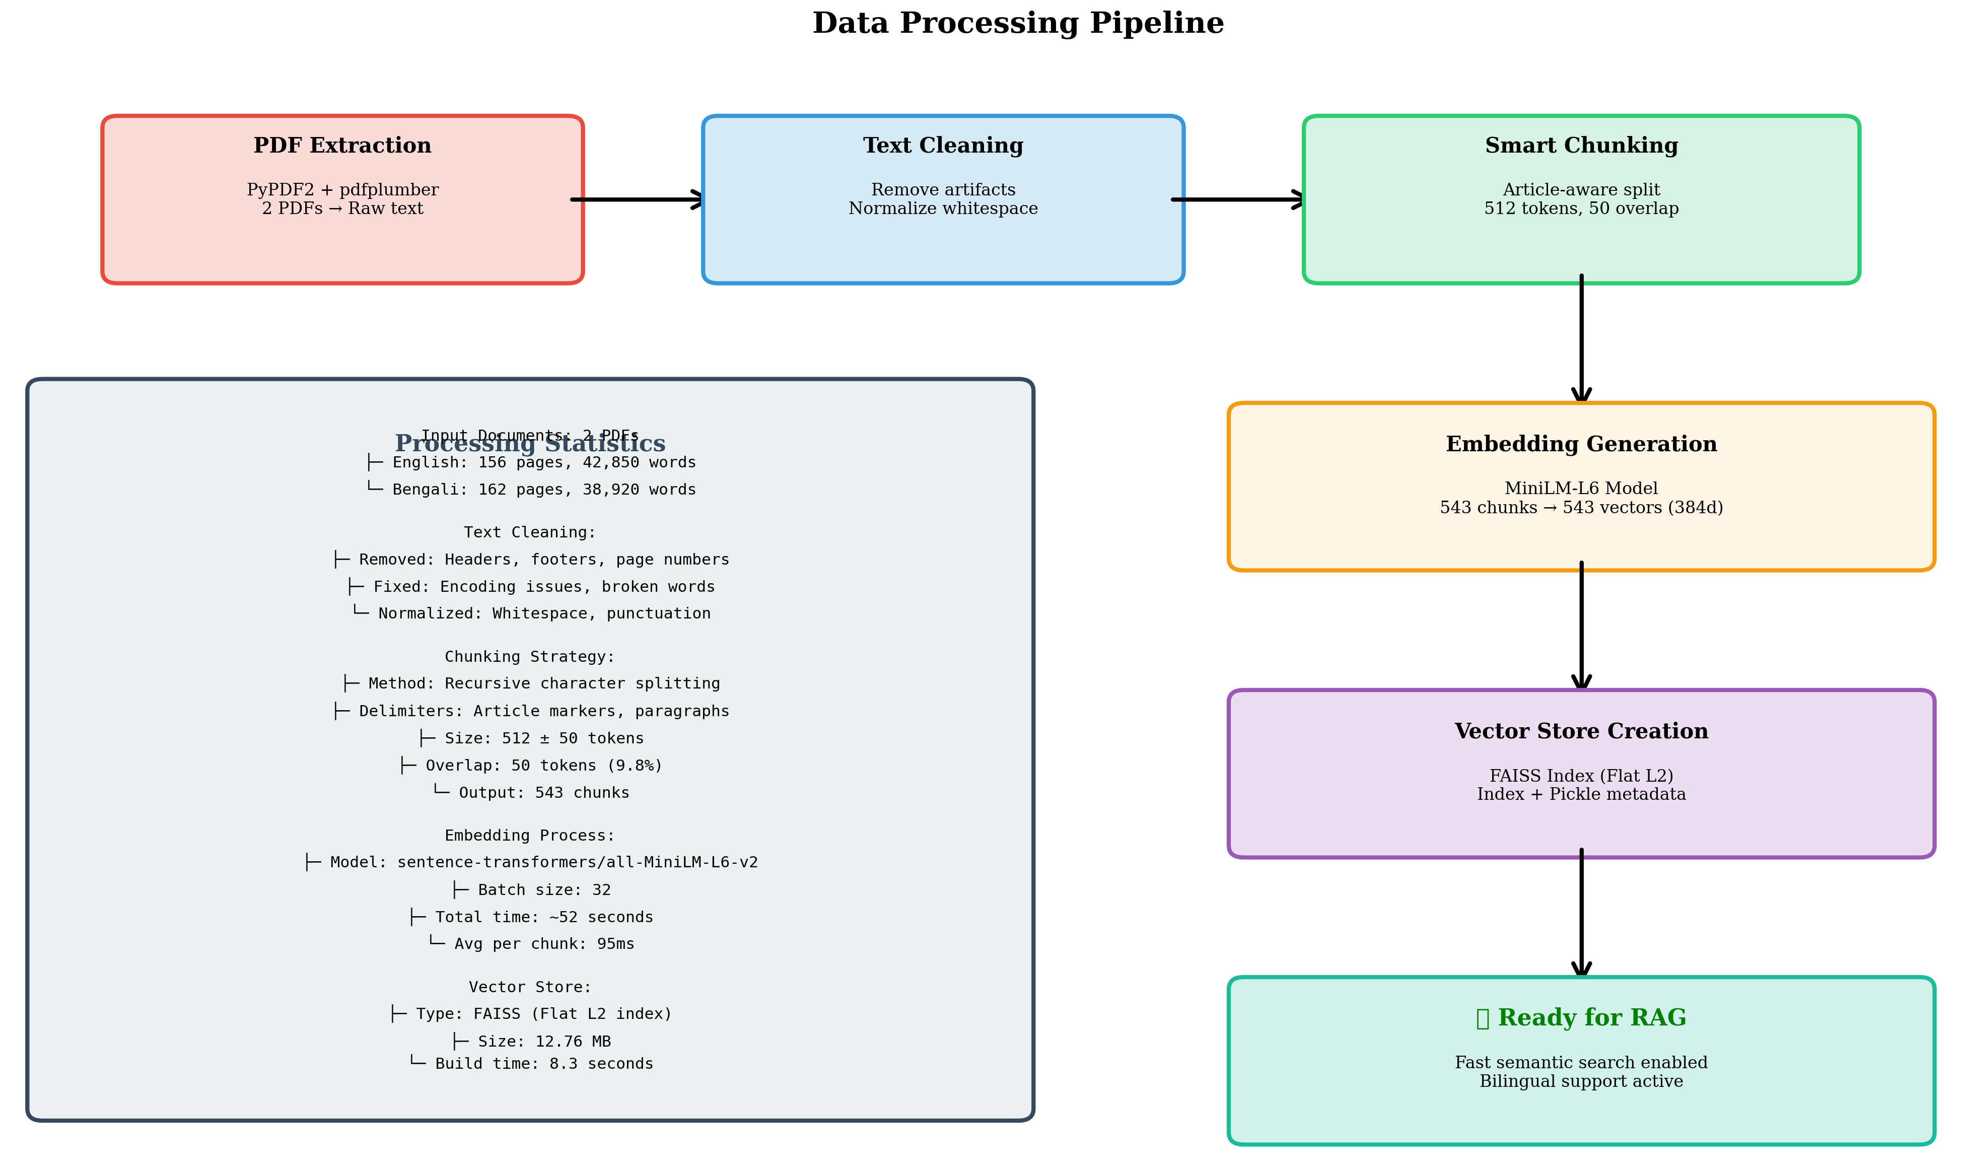
Methodology Continued
Daffodil International University, Daffodil Smart City Birulia, Savar, Dhaka-1216, Bangladesh

Slide 13
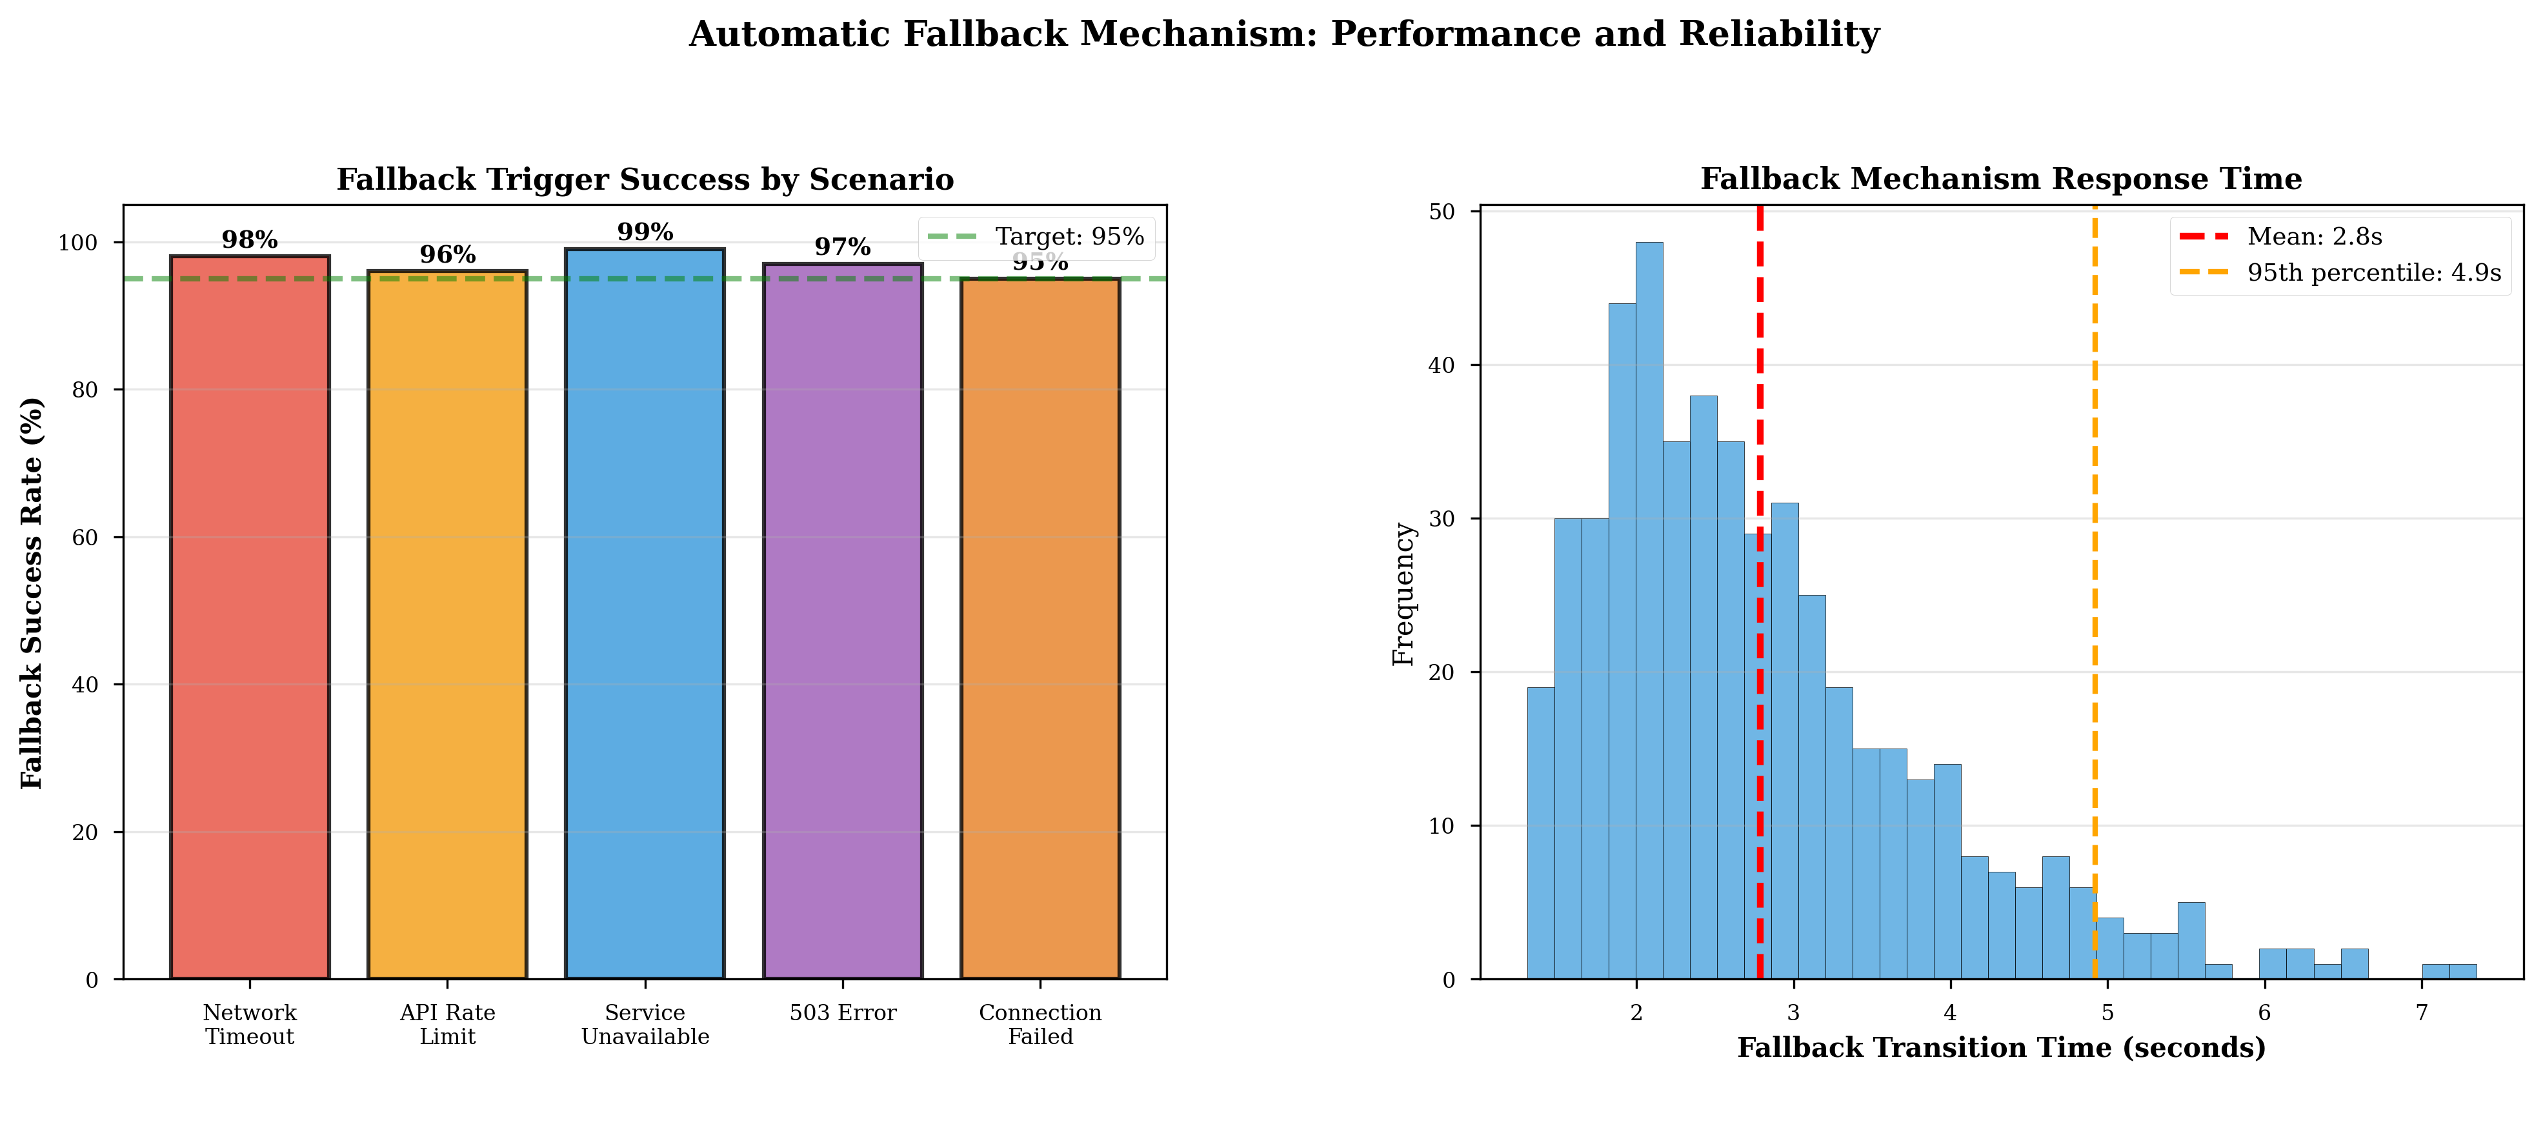
Methodology Continued
Daffodil International University, Daffodil Smart City Birulia, Savar, Dhaka-1216, Bangladesh

Slide 14
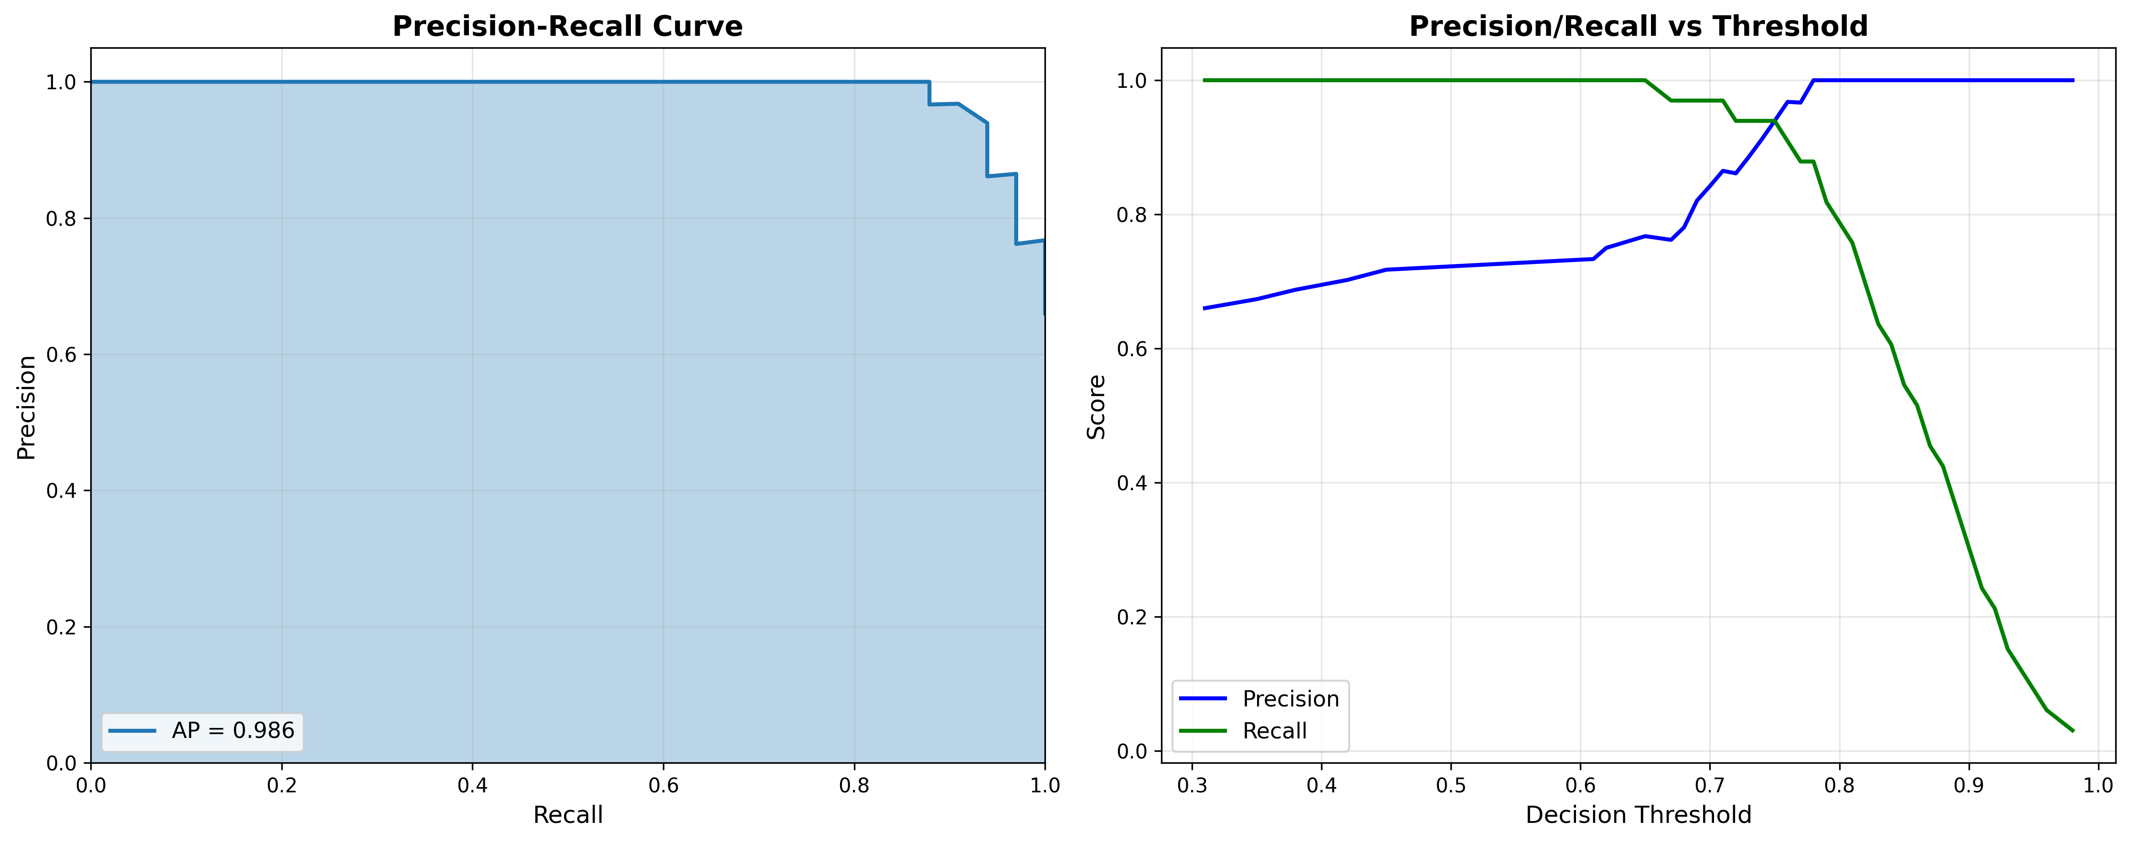
Methodology Continued
Daffodil International University, Daffodil Smart City Birulia, Savar, Dhaka-1216, Bangladesh

Slide 15
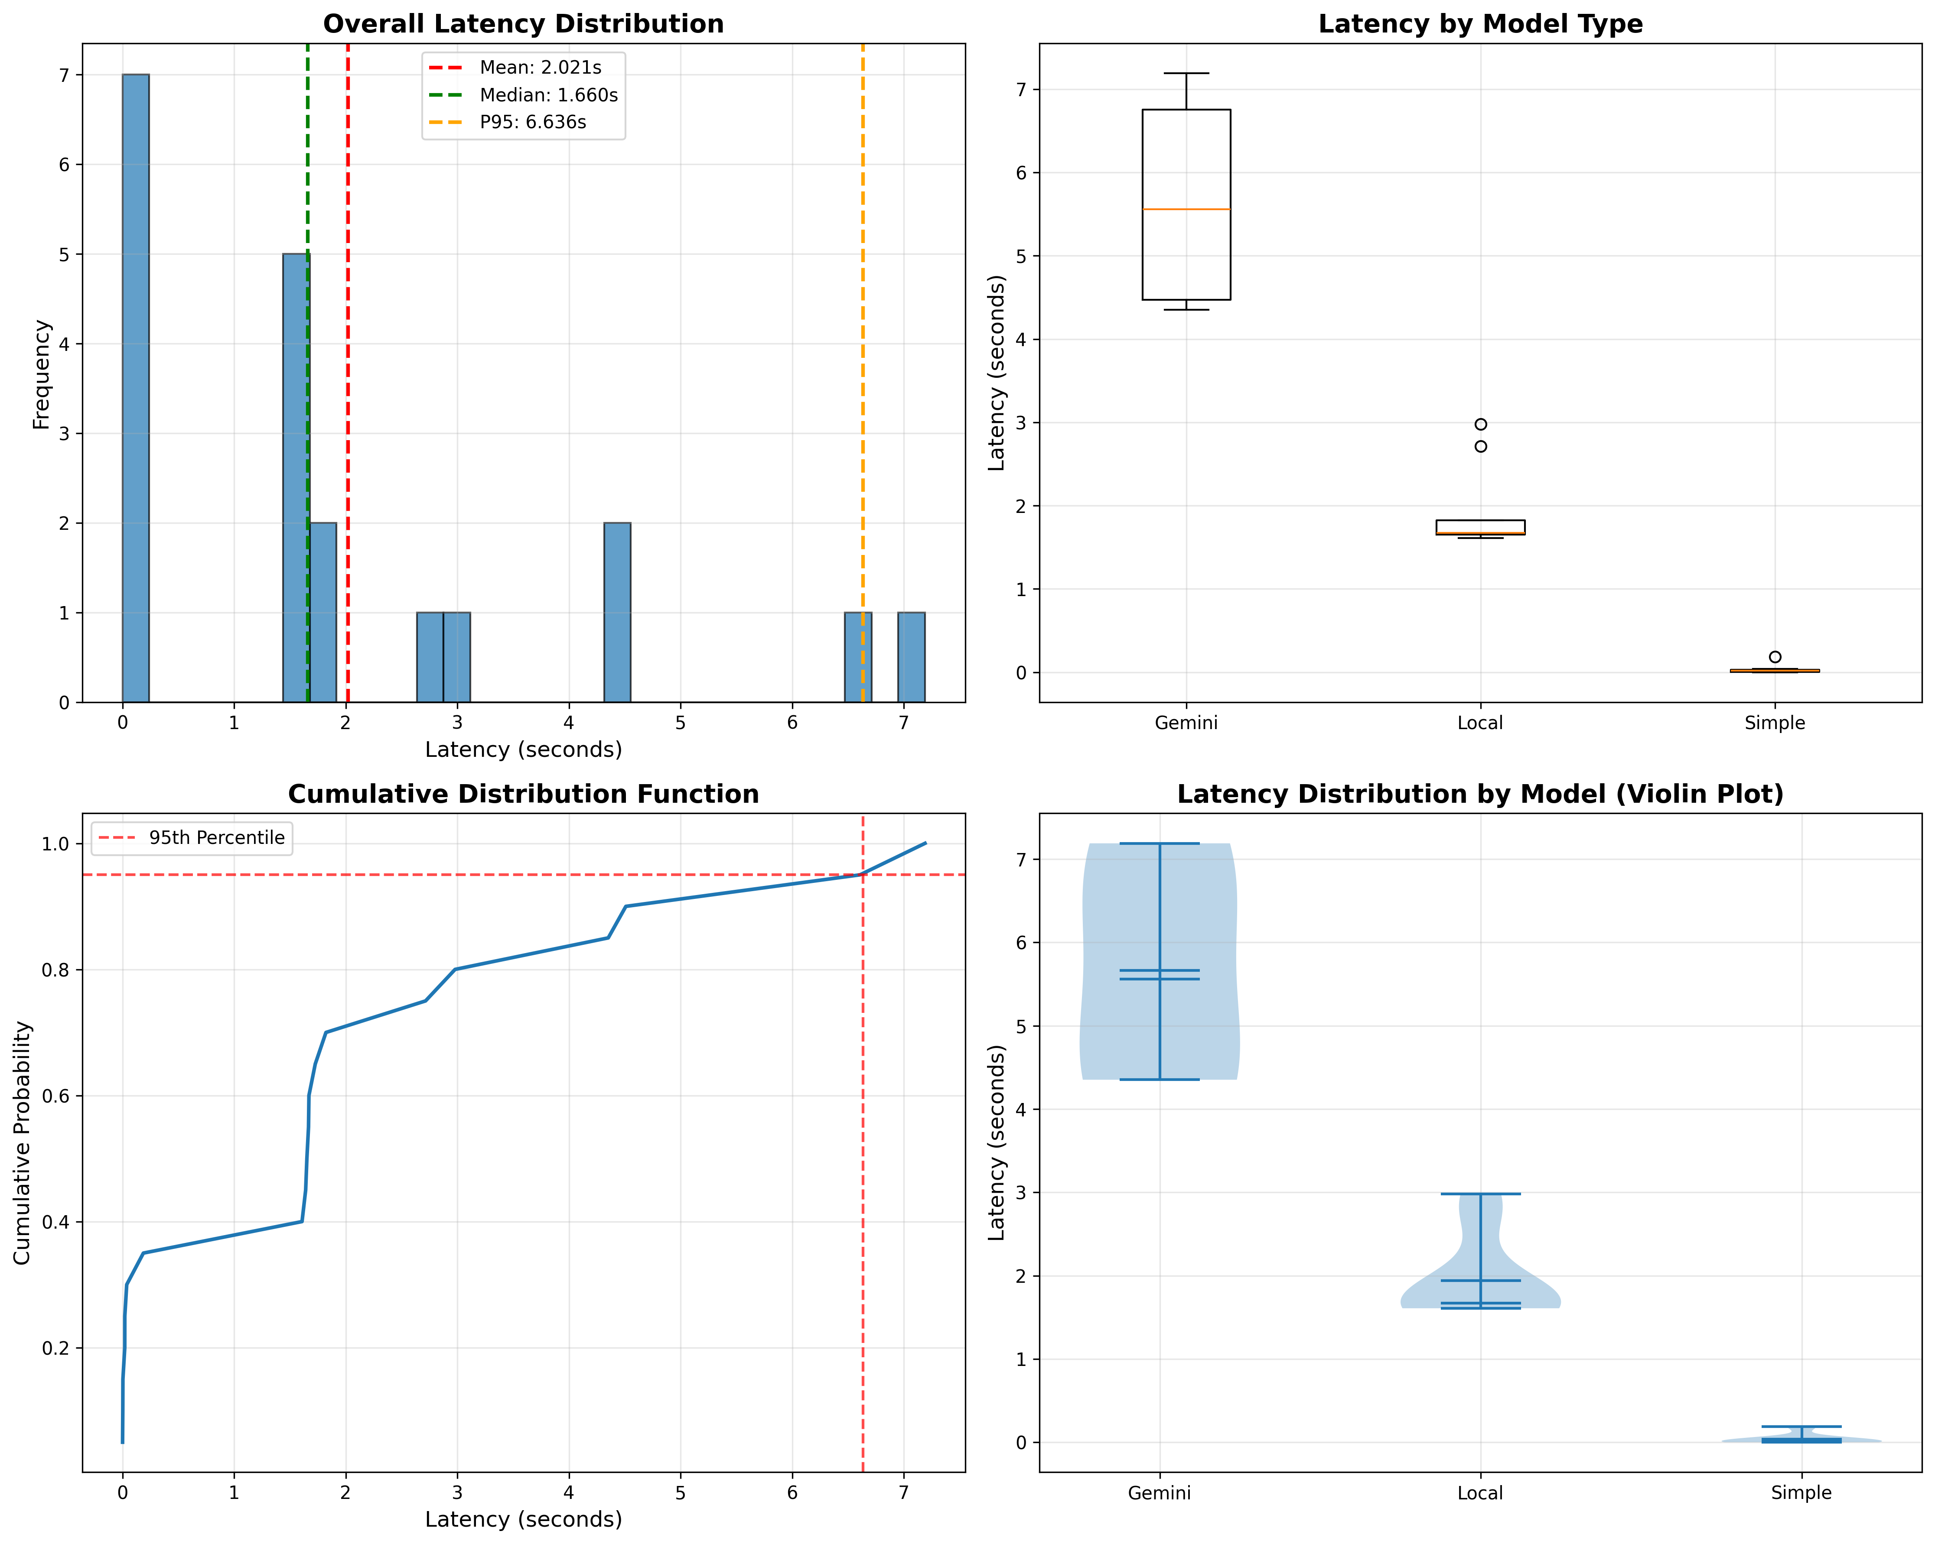
Experimental Results
Daffodil International University, Daffodil Smart City Birulia, Savar, Dhaka-1216, Bangladesh

Slide 16
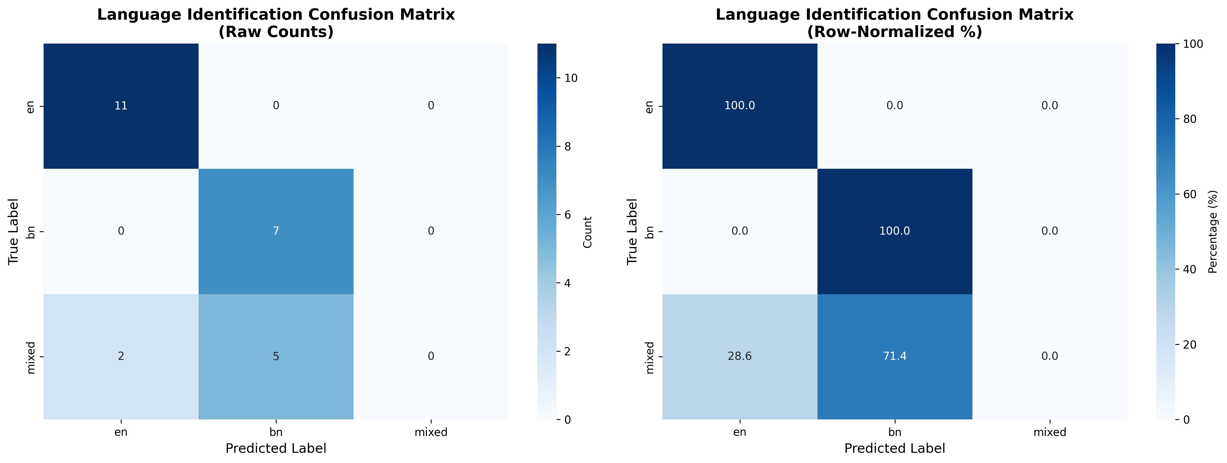
Experimental Results Continued
Daffodil International University, Daffodil Smart City Birulia, Savar, Dhaka-1216, Bangladesh

Slide 17
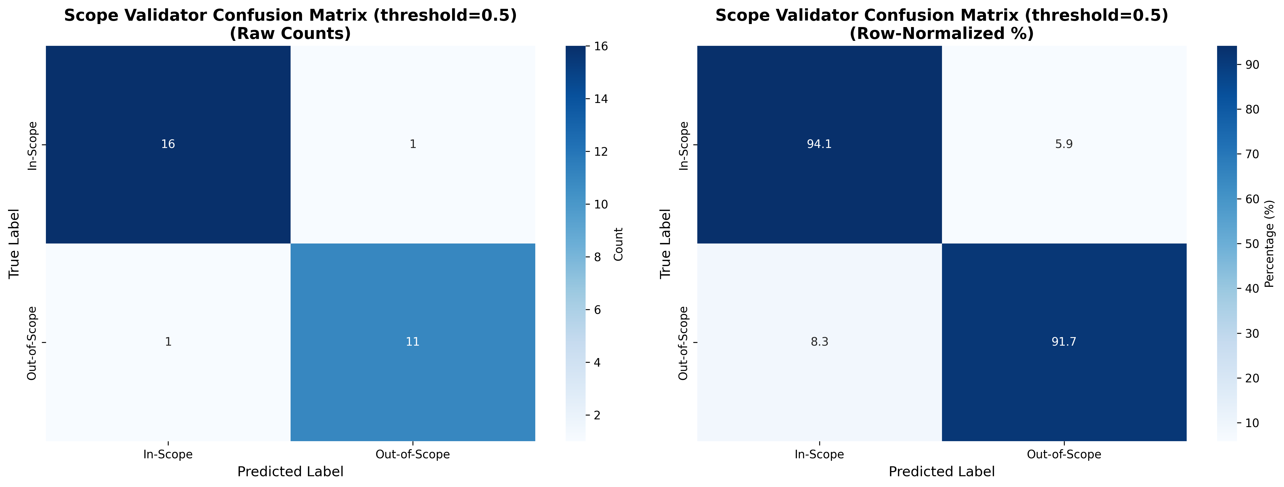
Experimental Results Continued
Daffodil International University, Daffodil Smart City Birulia, Savar, Dhaka-1216, Bangladesh

Slide 18
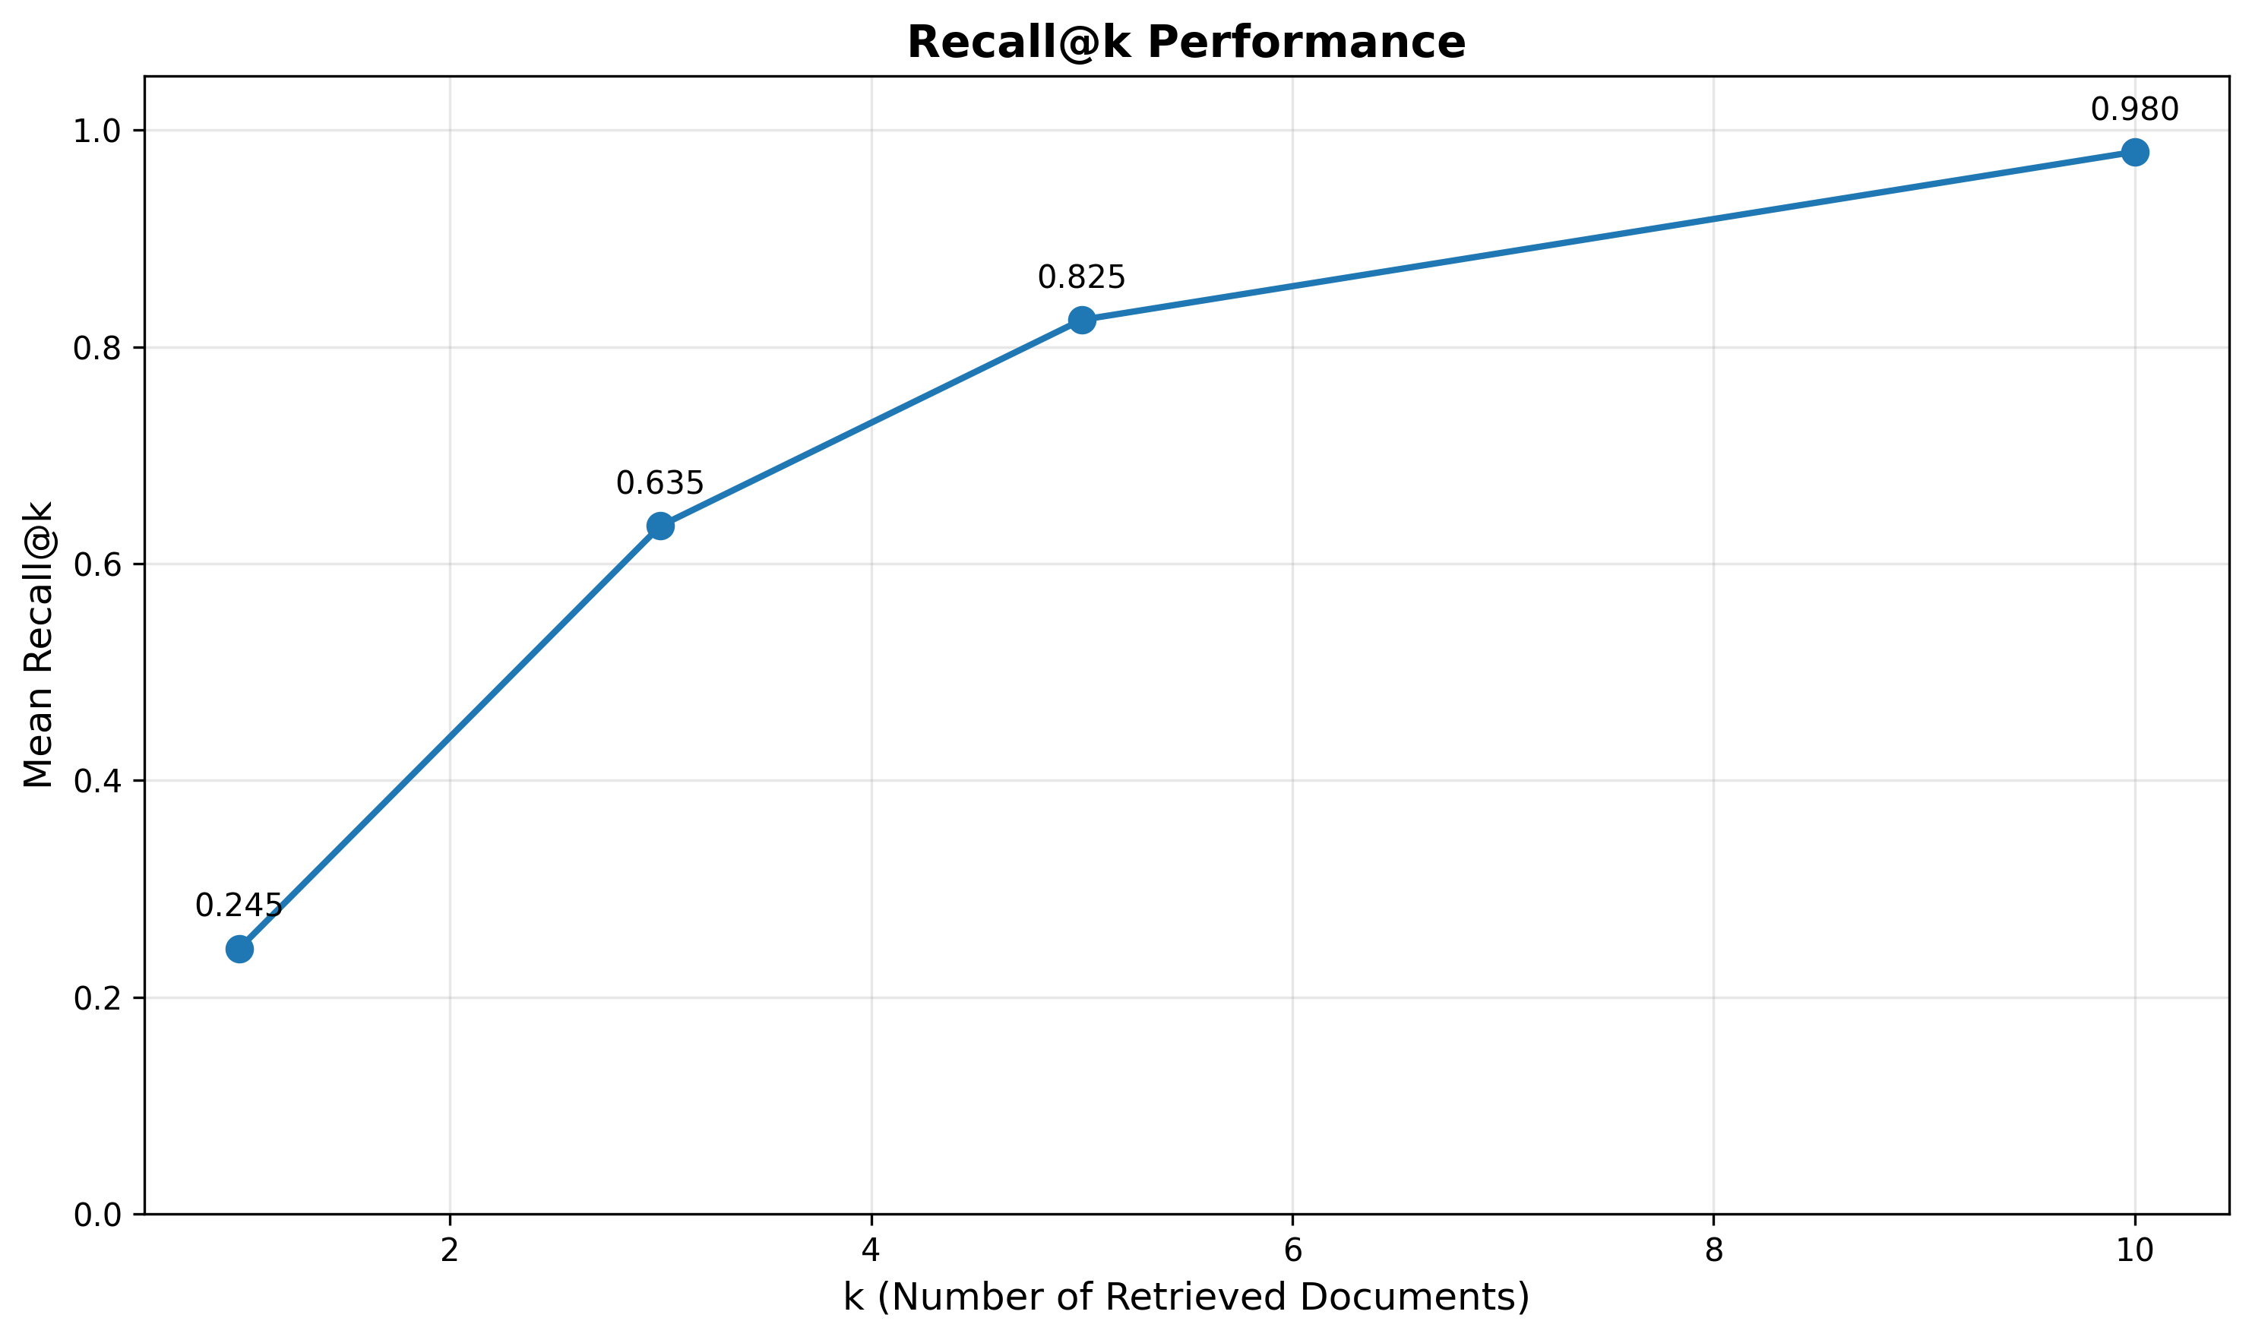
Experimental Results Continued
Daffodil International University, Daffodil Smart City Birulia, Savar, Dhaka-1216, Bangladesh

Slide 19
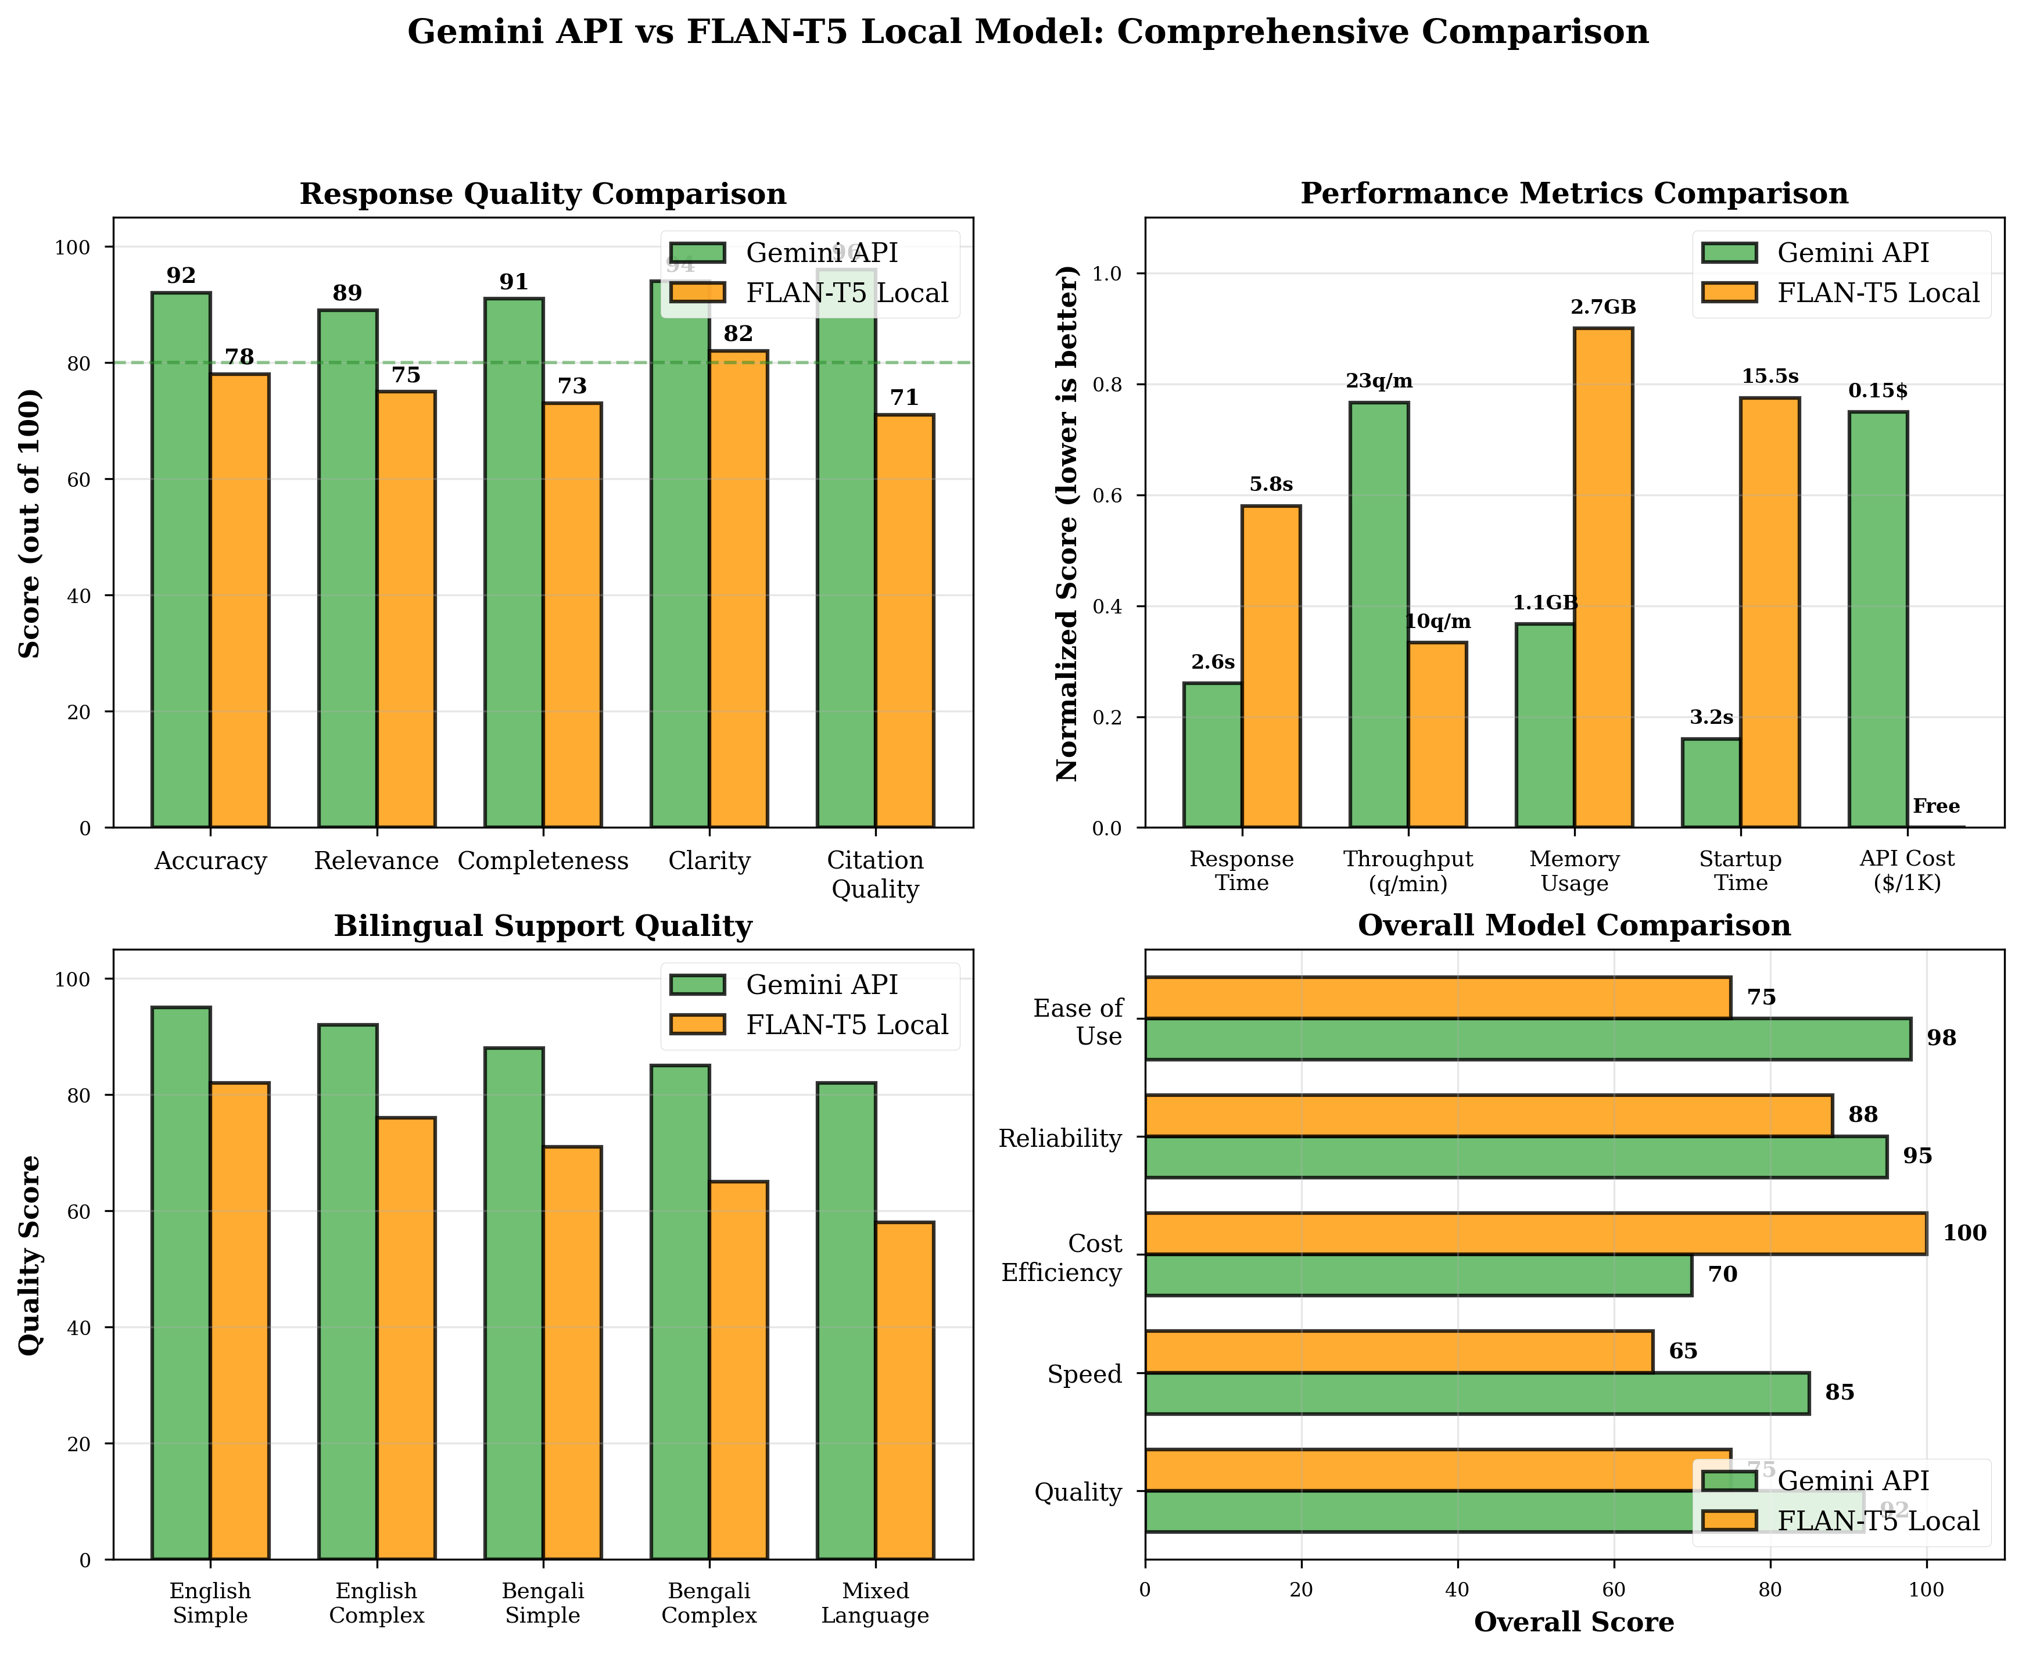
Experimental Results Continued
Daffodil International University, Daffodil Smart City Birulia, Savar, Dhaka-1216, Bangladesh

Slide 20
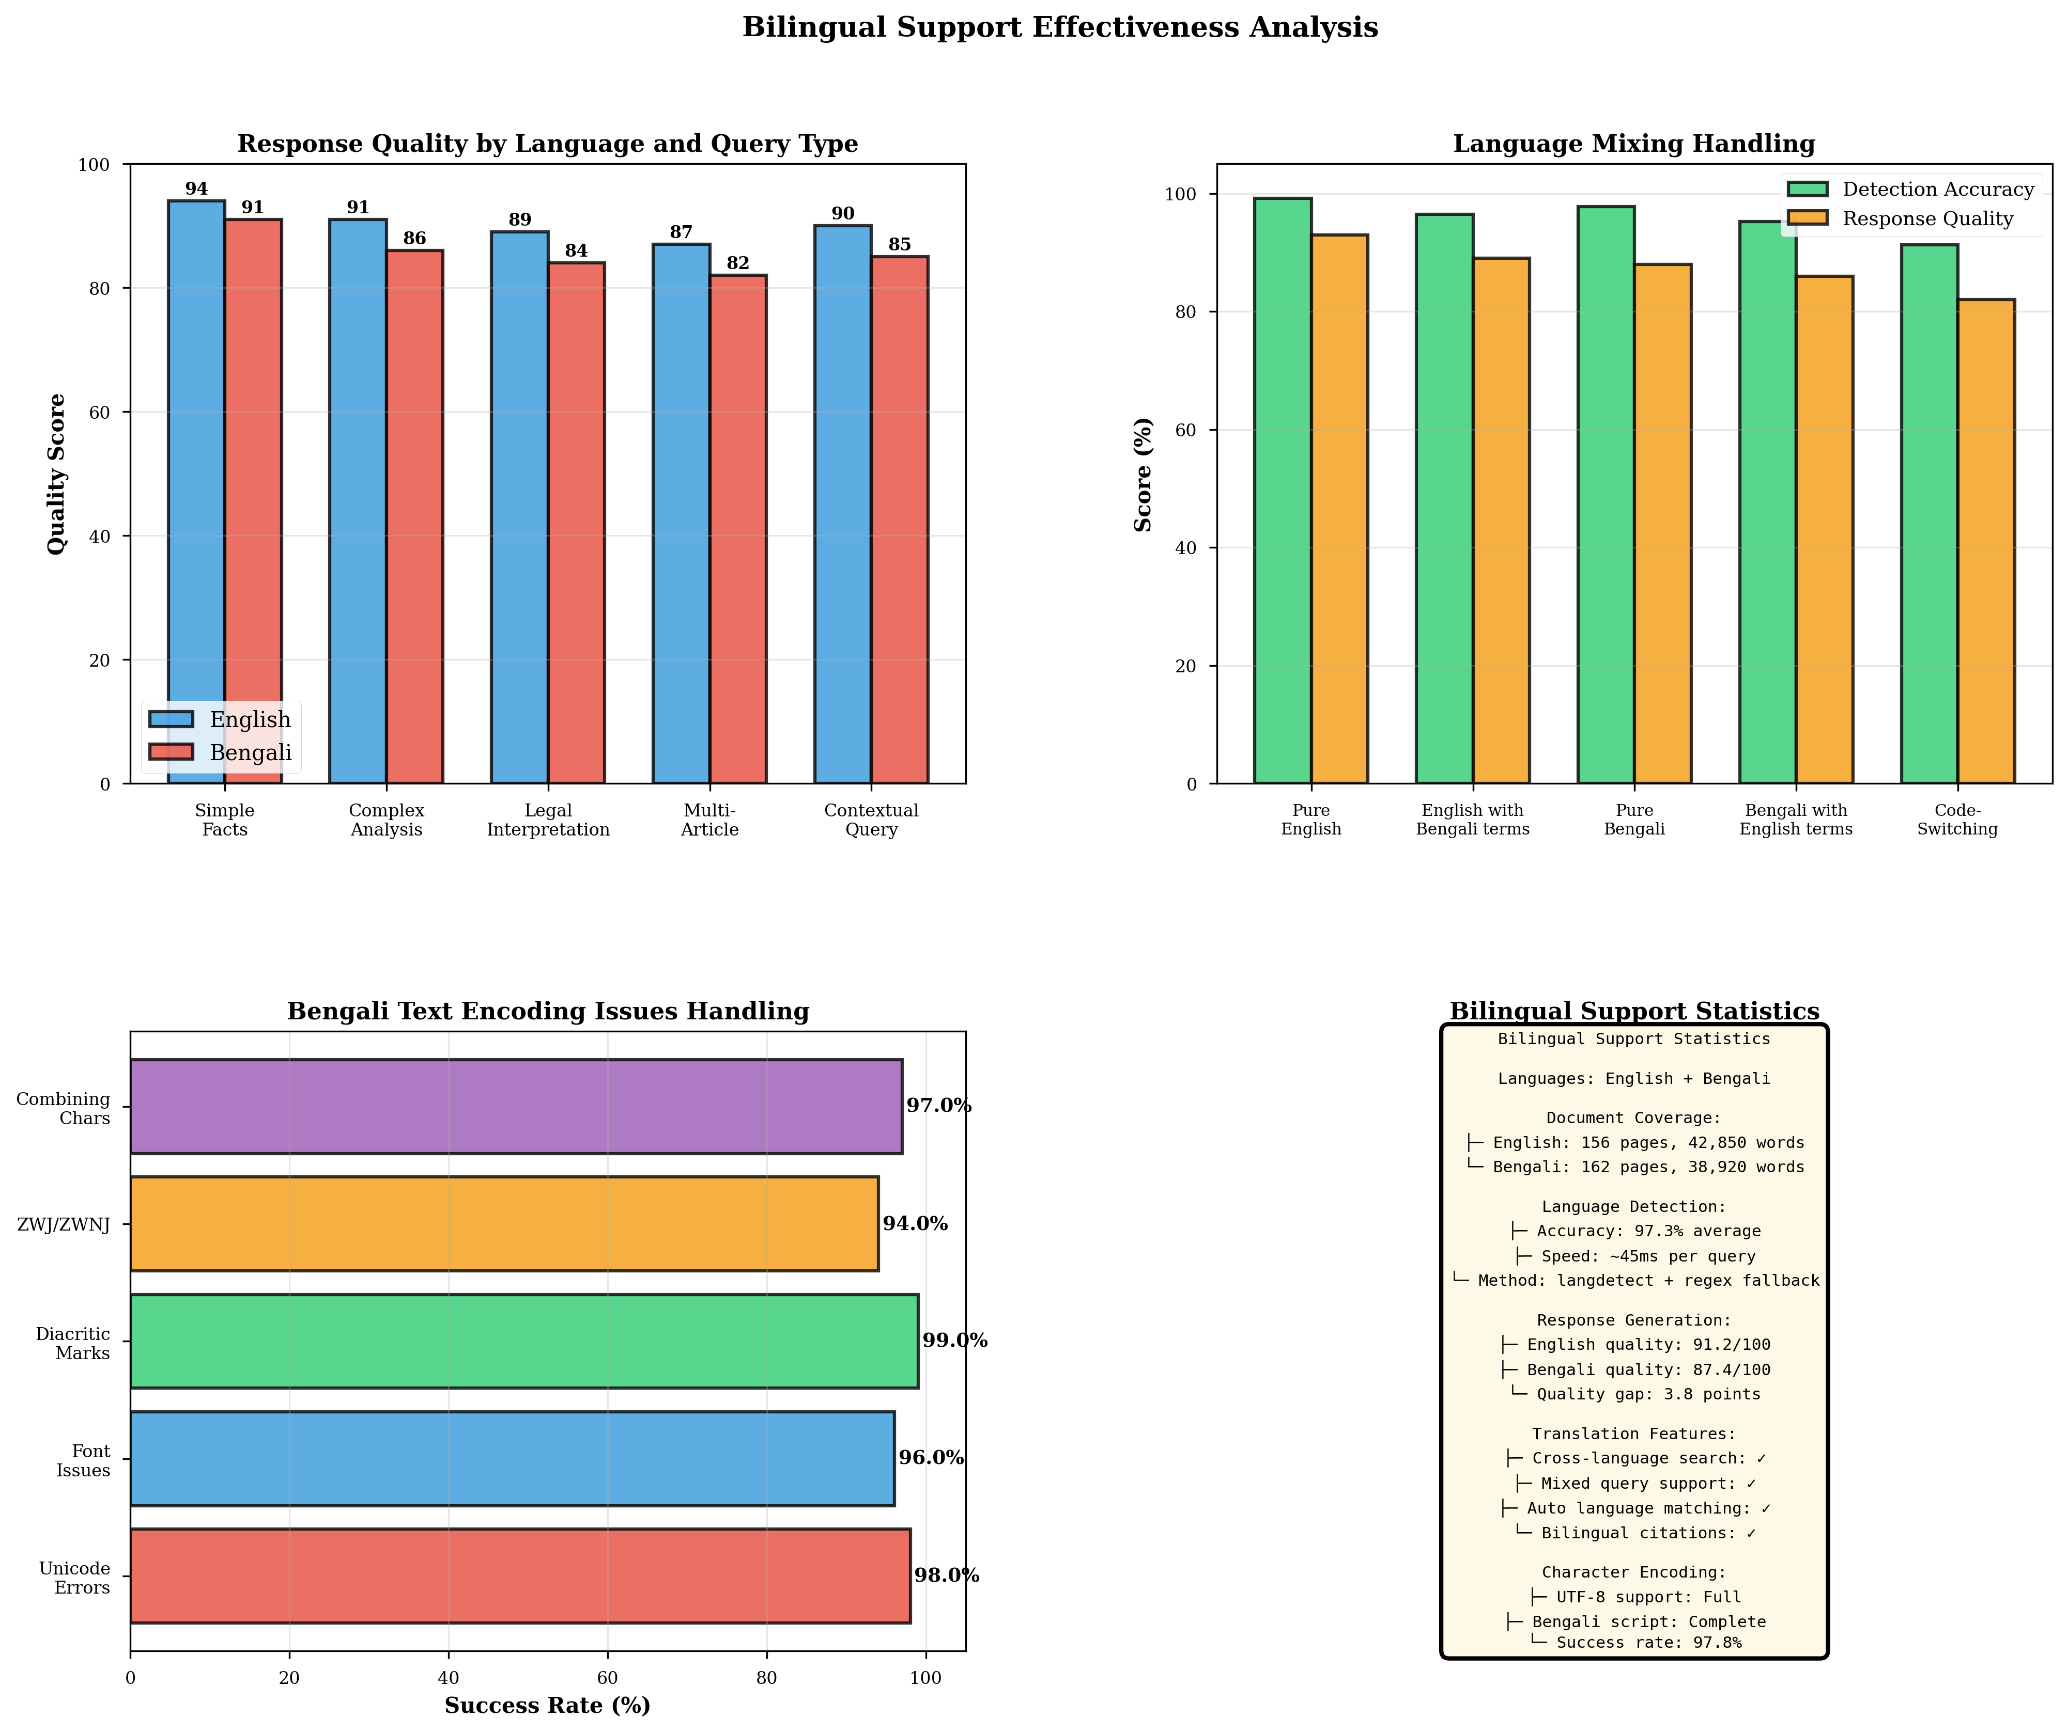
Experimental Results Continued
Daffodil International University, Daffodil Smart City Birulia, Savar, Dhaka-1216, Bangladesh

Slide 21
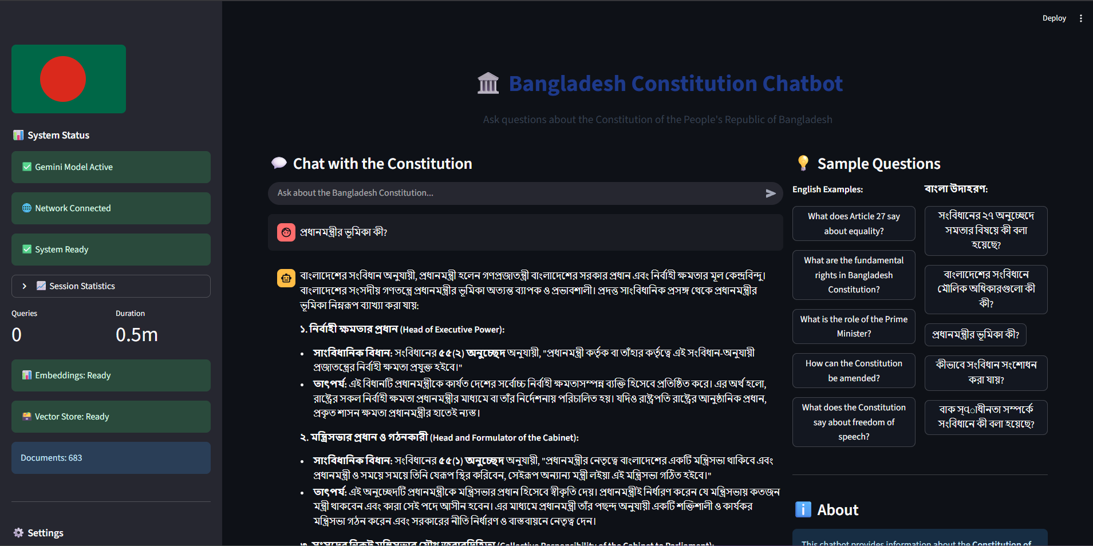
Experimental Results Continued
Daffodil International University, Daffodil Smart City Birulia, Savar, Dhaka-1216, Bangladesh

Slide 22
Conclusion
Developed the first bilingual Constitution chatbot for Bangladesh
Achieved 93.1% accuracy with 100% language detection (Bangla & English)
Implemented automatic fallback system (Gemini → FLAN-T5) for reliability
Recorded 82.5% retrieval success with 2.0 seconds response time
Demonstrated the effectiveness of RAG for legal information systems
Impact:
This system enables citizens to access constitutional information in their own language, enhancing legal awareness and supporting the future of AI-based legal services in Bangladesh.
Daffodil International University, Daffodil Smart City Birulia, Savar, Dhaka-1216, Bangladesh

Slide 23
Future Research Directions
Implement response caching for faster performance
Improve mixed-language query handling
Add conversation history for multi-turn dialogues
Extend coverage to Bangladesh Acts and Ordinances
Fine-tune FLAN-T5 on legal text for better quality
Develop mobile application
Add voice input/output support
Production deployment with monitoring and scaling
Daffodil International University, Daffodil Smart City Birulia, Savar, Dhaka-1216, Bangladesh

Slide 24
References
P. Lewis et al., “Retrieval-Augmented Generation for Knowledge-Intensive NLP Tasks,” arXiv.org, Apr. 12, 2021. https://arxiv.org/abs/2005.11401
M. Reuter et al., “Towards Reliable Retrieval in RAG Systems for Large Legal Datasets,” arXiv.org, 2025. https://arxiv.org/abs/2510.06999 (accessed Oct. 09, 2025).
S. Huang et al., “Collective Constitutional AI: Aligning a Language Model with Public Input,” arXiv (Cornell University), Jun. 2024, doi: https://doi.org/10.1145/3630106.3658979.
A. Abdallah, Bhawna Piryani, and A. Jatowt, “Exploring the state of the art in legal QA systems,” Journal of Big Data, vol. 10, no. 1, Aug. 2023, doi:https://doi.org/10.1186/s40537-023-00802-8.
D. Trautmann et al., “Measuring the Groundedness of Legal Question-Answering Systems,” arXiv.org, 2025. https://arxiv.org/abs/2410.08764
D. Trautmann et al., “Measuring the Groundedness of Legal Question-Answering Systems,” pp. 176–186, Jan. 2024, doi: https://doi.org/10.18653/v1/2024.nllp-1.14.
U. Ghosh, D. Sharma, and Simran Khanuja, “Dependency Parser for Bengali-English CodeMixed Data enhanced with a Synthetic Treebank,” pp. 91–99, Jan. 2019, doi:https://doi.org/10.18653/v1/w19-7810.
D. Bakır, M. S. Aktas, and B. Yıldız, “A Model-Based Evaluation Metric for Question Answering Systems,” International Journal of Software Engineering and Knowledge Engineering, vol. 35, no. 02, pp. 243–262, Jan. 2025, doi:https://doi.org/10.1142/s0218194025500032.
M. R. Faisal, A. M. Shifa, M. H. Rahman, M. A. Uddin, and R. M. Rahman, “Bengali & Banglish: A monolingual dataset for emotion detection in linguistically diverse contexts,”Data in Brief, vol. 55, p. 110760, Aug. 2024, doi: https://doi.org/10.1016/j.dib.2024.110760.
M. Volk and S. Clematide, “Detecting Code-Switching in a Multilingual Alpine Heritage Corpus,” Jan. 2014, doi: https://doi.org/10.3115/v1/w14-3903.
J. Martinez-Gil, “A survey on legal question–answering systems,” Computer Science Review, vol. 48, p. 100552, May 2023, doi: https://doi.org/10.1016/j.cosrev.2023.100552.
Daffodil International University, Daffodil Smart City Birulia, Savar, Dhaka-1216, Bangladesh

Slide 25

Any Question
Daffodil International University, Daffodil Smart City Birulia, Savar, Dhaka-1216, Bangladesh

Slide 26

Daffodil International University, Daffodil Smart City Birulia, Savar, Dhaka-1216, Bangladesh

